Slide 1
IP Headroom
AWS Subnet IP Address Exhaustion
https://github.com/davidkshepherd/IPHeadroom

Slide 2
Background
Internet
Security Groups (SGs) needed for internet traffic in/out of AWS
They are like Firewalls
Allow some traffic (ex: web)
Block other traffic (ex: db access)
SGs are attached to subnets (IP address ranges) to channel traffic
Typically subnets are small segments of a larger CIDR range
You are probably familiar with Class C size subnets, like:
192.168.0.0/24
254 IP addresses (192.168.0.1 - 192.168.0.254)
2 smaller subnets
Web - 192.168.0.0/25 = 128 IP addresses (192.168.0.0 - 192.168.0.127)
DB - 192.168.0.128/25 = 128 IP addresses (192.168.0.128 - 192.168.0.254)
SG
subnets
Web site
database

Slide 3
Background - Scaling
Scaling is key to effective Cloud usage
When Traffic is High: Scale UP!
When Traffic is Low: Scale DOWN!
Why?
Improve security (fewer targets to attack)
Save LOADS of Money

Slide 4
Problem
Scaling Up requires available IP addresses
Running out of IP addresses in your subnet is BAD
Services don’t scale
Traffic slows
Sites fail
Sales missed
Transactions lost
Customers complain
Customers leave

Slide 5
Solution
Know how many IPs are available in your Subnet
Know roughly how much you will need to scale
2x?
10x?
50x?
100?
Make sure you have enough room for your peek (and some extra)

Slide 6
Gather your Subnet Info
Straight from AWS APIs
Pull in to a data Set
Analyze Subnet Size, Current Usage, Available Space

Slide 7
IP Headroom
Evaluate Subnets
How much “Headroom” do we have?
Report on anything below the targeted peak
Fix it now (before we scale)

Slide 8
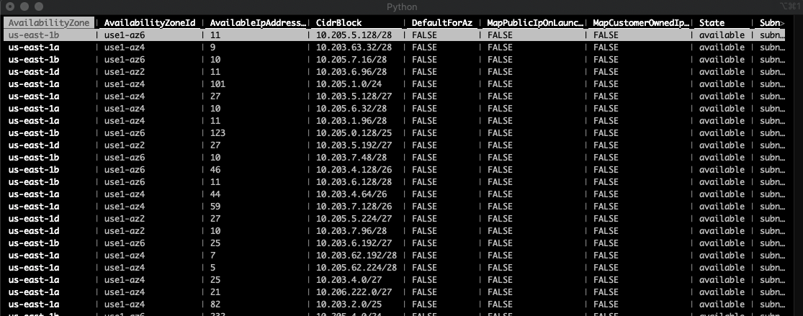
Data Set - subnets.csv

Slide 9
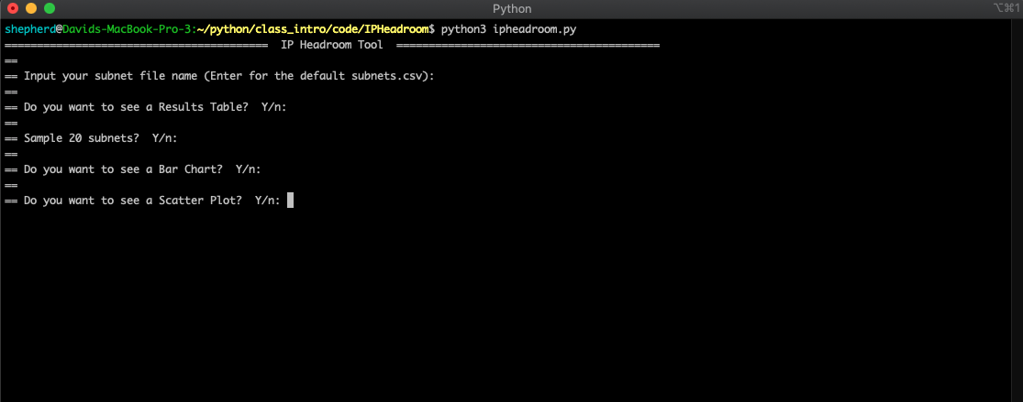
Setting up Evaluation

Slide 10
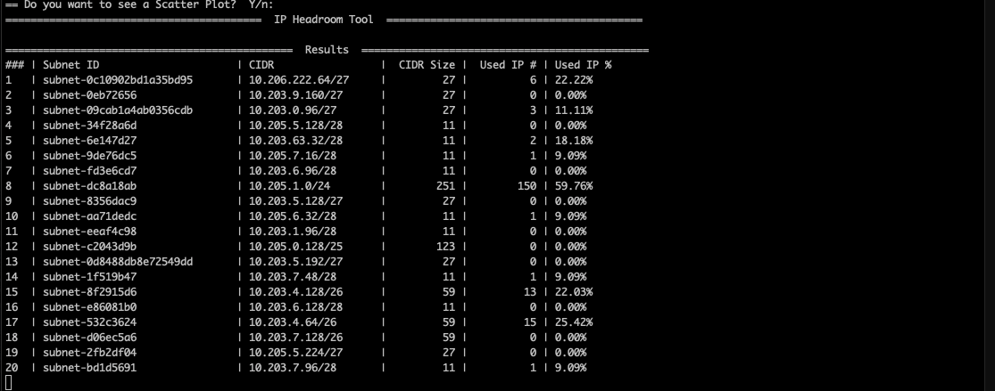
Data Table of Results

Slide 11
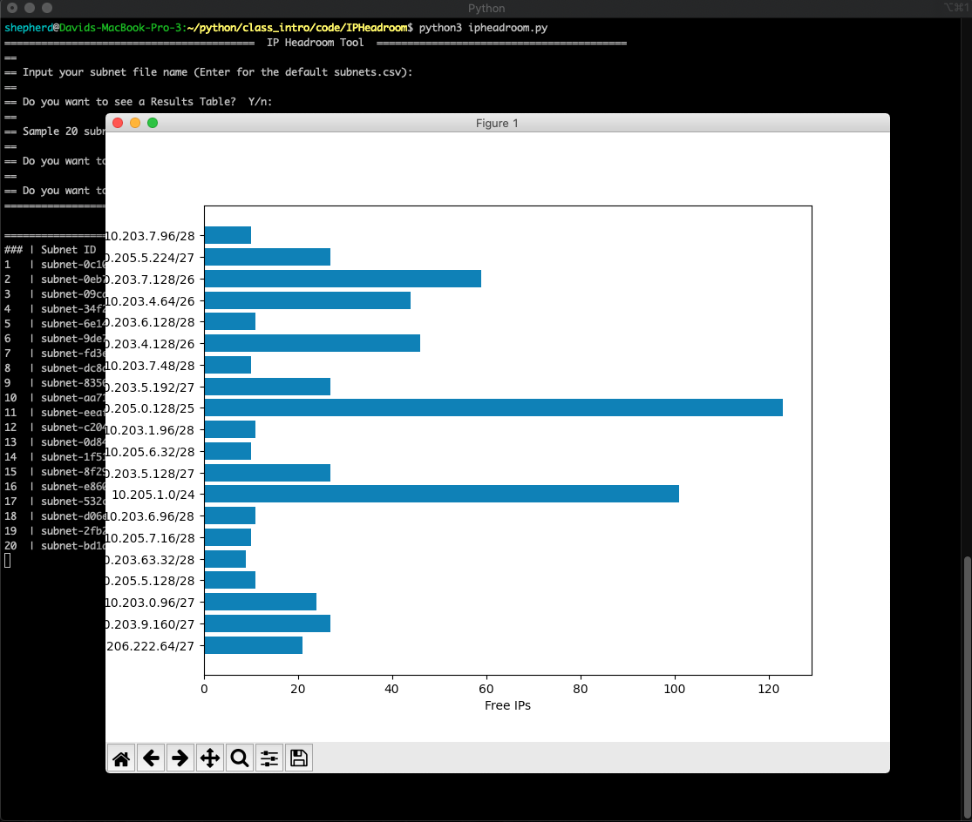
Horizontal Bar Chart

Slide 12
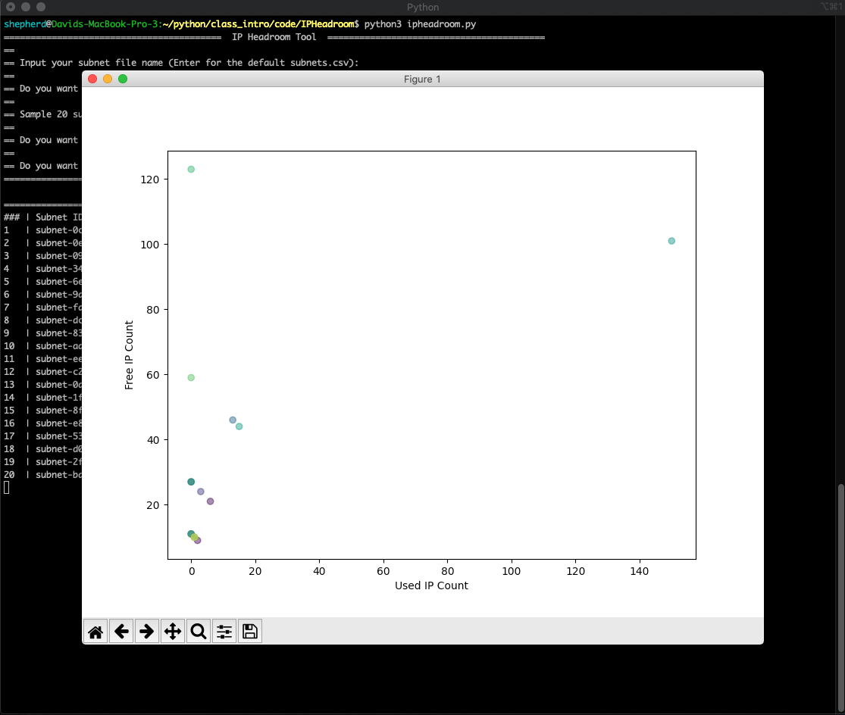
Scatter Plot

Slide 13
Background
Security Groups (SGs) needed for internet traffic in/out of AWS
They are like Firewalls
Allow some traffic (ex: web)
Block other traffic (ex: db access)
SGs are attached to subnets (IP address ranges) to channel traffic
Typically subnets are small segments of a larger CIDR range
You are probably familiar with Class C size subnets, like:
192.168.0.0/24
254 IP addresses (192.168.0.1 - 192.168.0.254)
2 smaller subnets
Web - 192.168.0.0/25 = 128 IP addresses (192.168.0.0 - 192.168.0.127)
DB - 192.168.0.128/25 = 128 IP addresses (192.168.0.128 - 192.168.0.254)

Slide 14
Background
Internet
Subnets are purpose built as small slices of a larger IP space
This allow segregation of traffic among security Zones
Separates traffic to your database from traffic to your customer
This is GOOD
SG
Web site
database
subnets

